Slide 1
Face Recognition in Noisy Environment using Artificial Neural Network
Ritesh Kumar Vangapalli 224/11

Slide 2
Project Overview
This project suggests new systematic analysis of faces images detection and recognition. The project combines two methods for face detection and recognition to achieve better detection rates in noisy environment.
Part 1: Eigen Faces
Provide brief description, if desired.
Part 2: LM Back Propagation Neural Network
Provide brief description, if desired.
Notes:
Lesson descriptions should be brief.

Slide 3
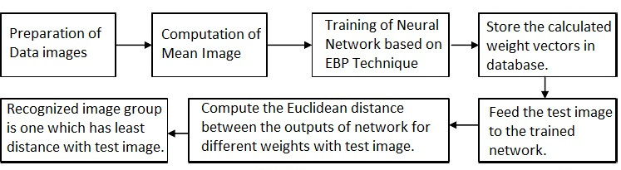
Block Diagram
Notes:
Example objectives
At the end of this lesson, you will be able to:
Save files to the team Web server.
Move files to different locations on the team Web server.
Share files on the team Web server.

Slide 4
NOISE
In any face capturing scheme, the presence of noise is eminent.
The common types of noises in an image are:
Guassian noise
Salt & Pepper noise
Poisson noise
We have designed a system which can recognize a face added with all the above noises

Slide 5
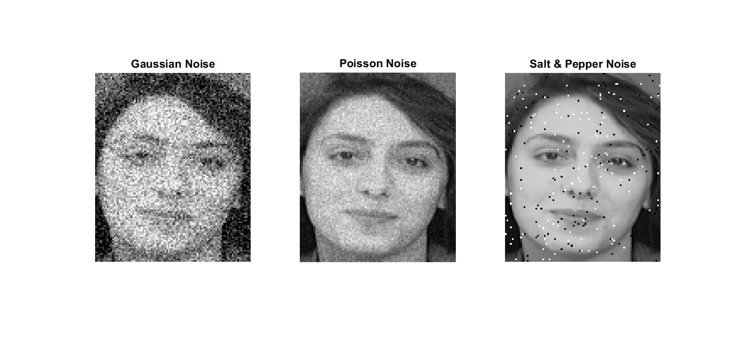
Common Noises in Images

Slide 6
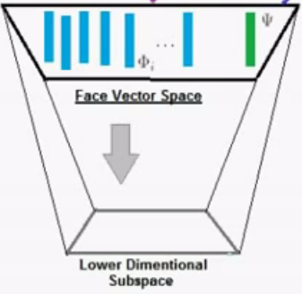
Face recognition based on Principle Component Analysis (PCA)
The basic idea in PCA is to determine the vector of much lower dimension that best approximates in some sense a given data vector. The dimension of this sub-space is lower than the original one.

Slide 7
Eigen Face Method
Eigen face method is a linear transformation that transforms the data to a new coordinate system such that the greatest variance by any projection of the data comes to lie on the first coordinate. Unlike other linear transforms the eigen face does not have a fixed set of basis vectors. Its basis vectors depend on data set.

Slide 8
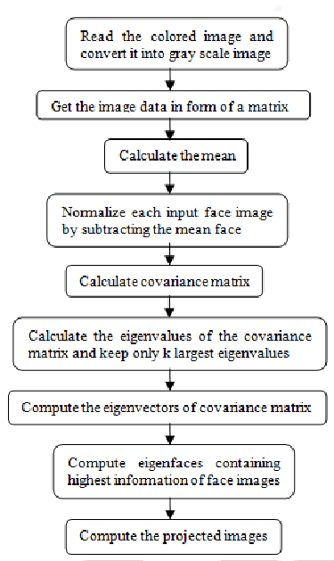
PCA Eigen Face Algorithm

Slide 9
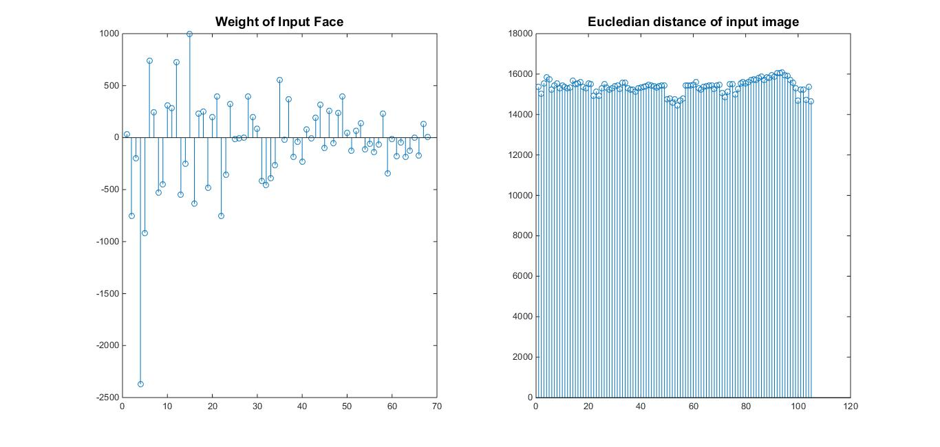

Euclidean Distance
Euclidean norm, or Euclidean length, or magnitude
of a vector measures the length of the vector:

Slide 10
Algorithm
Step 1:
Step 2:
Step 3:
Step 4:
Step 5:
Step 6:
Step 7:
Start
Create Face database
Compute Eigen Faces
Train using obtained weights
Image Acquisition
Face Recognition
Go to Step 1
Notes:
Lesson descriptions should be brief.

Slide 11
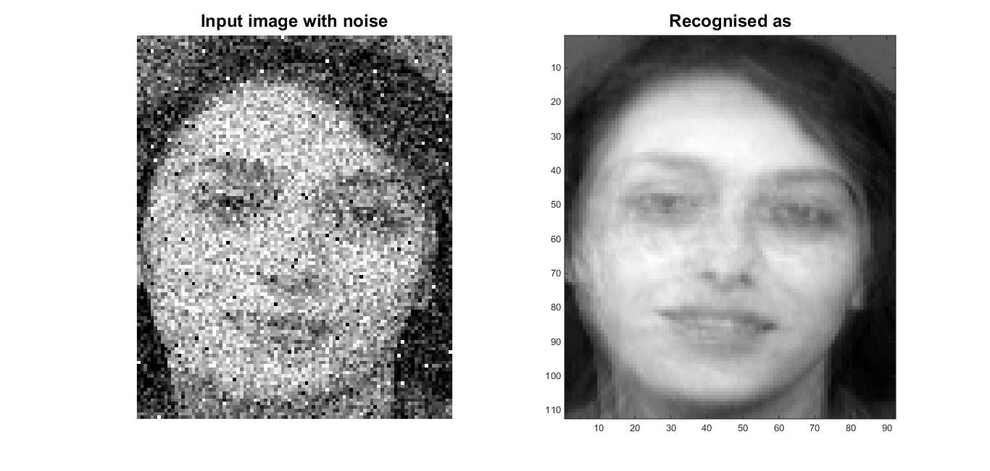
Face Recognition in Noisy Environment

Slide 12
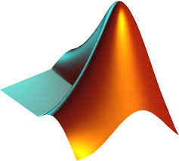
Software
MATLAB R2015b

Slide 13
Matlab functions used
Learngdm
Dividerand
Mse
Initnw()
Trianlm()
Tansig()

Slide 14
Trainlm()
It is the matlab function used to train our neural networks with the different faces in the face database.
It is a networking training algorithm which updates weights and bias values according to the Levenberg-Marquardt optimization.

Slide 15
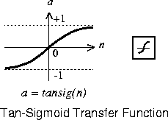
Tan-sigmoid function (tansig)
Tansig() or tan-sigmoid function is the transfer function from the input layer to the two hidden layers and from the hidden layers to the output
It adaptively updates the weights of the neural network we use.

Slide 16
Initnw()
Initnw() is a layer initialization function that initializes layer’s weights and biases according to the Nguyen-Widrow initialization algorithm.
This algorithm chooses values in order to distribute the active region of each neuron in the layer approximately evenly across the layer's input space.
The values contain a degree of randomness, so they are not the same each time this function is called.

Slide 17
Applications
Crowd
Surveillance
Video Content
Indexing
Personal
Identification
Applications
Applications
Mug shot
matching
Real Time Face
Recognition
Automatic
attendance

Slide 18
Conclusion
We have been successful in making a computational model of face database system using the eigenface algorithm and have also been successful in training the system using Error Back Propogation Algorithm. We have recognised all these images in noisy environment.

Slide 19
References
[1] Mohammod Abul Kashem, Md. Nasim Akhter, Shamim Ahmed, and Md. Mahbub Alam, ”Face Recognition System Based on Principal Component Analysis (PCA) with Back Propagation Neural Networks (BPNN)” ISSN 2229-5518. International Journal of Scientific & Engineering Research Volume 2, Issue 6, June-2011
[2] M.Nandini, P.Bhargavi, G.Raja Sekhar,”Face Recognition using Neural Networks” ISSN 2250-3153. International Journal of Scientific and Research Publications, Volume 3, Issue 3, March 2013.
[3] Mayank Agarwal, Nikunj Jain, Mr. Manish Kumar and Himanshu Agrawal, “Face Recognition Using Eigen Faces and Artificial Neural Network” ISSN 1793-8201.
International Journal of Computer Theory and Engineering, Vol. 2, No. 4, August, 2010.
[4]Matthew Turk and Alex Pentland, “Journal of Cognitive Neuroscience”. Massachusetts Institute of Technology, 1991.
[5] Ms. Sneha P. Wandale, Prof. P.A.Tijare and Prof. S.N.Sawalkar, “Principal Component Analysis (PCA) with Back Propogation Neural Network(BPNN) for Face Recognition System”, ISSN 2319-4847. International Journal of Application or Innovation in Engineering & Management (IJAIEM), Volume 2, Issue 4, April 2013.
[6] Hassan Fahmy Hashem, “Ability of Neural Network to Detect and Recognize of Faces Images in Noisy Environment”,IEEE NEUREL-2008, 9th Symposium on Neural Network Applications in Electrical Engineering, September 25-27, 2008.
[7] Prof.Ujval Chaudhary, Chakoli Mateen Mubarak, Abdul Rehman, Ansari Riyaz, Shaikh Mazhar, “ Face Recognition Using PCA-BPNN Algorithm”, ISSN: 2249-6645. International Journal of Modern Engineering Research (IJMER), Vol.2, Issue.3, May-June 2012 pp-1366-1370.
[8] Steve Lawrence, C. Lee Giles, Ah Chung Tsoi, Andrew D. Back, “A Convolutional Neural Network Approach”, Accepted for publication, IEEE Transactions on Neural Networks, Special Issue on Neural Networks and Pattern Recognition.

Slide 20
Thank You!

